Slide 1

Artificial Intelligence in the Intensive Care Unit
Andrew Neary (a.neary6@nuigalway.ie)
Supervisor: Prof. Michael Madden
Notes:
Introduce myself
Thank you for coming
Overview of talk:
Background on what I’ve been up to
What I’m interested in next (MV)
Their perspective as clinicians

Slide 2
My PhD so far
Needed to gain experience working with medical/ICU data
“Benchmarking deep learning models on large healthcare datasets”
Purushotham et al, 2018 ^{[1]}
Assessed the performance of different models on a range of clinical tasks
Goal: replicate their results as a learning experience
Notes:
Medical background
Some experience with machine learning during my MSc

Slide 3
Mortality Prediction
38,549 adult patients from the MIMIC-III database
16 features for each patient
Age, heart rate, systolic blood pressure, temperature, GCS, P_{a}O₂, F_{i}O₂, urine output, urea, bicarb, sodium, potassium, bilirubin, WBCs, chronic diseases, admission type
Predicting the probability of surviving the hospital stay

Slide 4
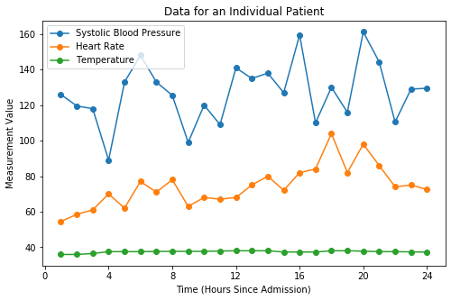
Data

Slide 5
The Classifiers
SAPS II
Clinical warning score taken from medical literature
Uses the same features to calculate probability of patient survival
Recurrent neural network
Gated Recurrent Unit (GRU)
Capture information in the time series data
Logistic regression
Used to benchmark results
Summary statistics calculated for time series features

Slide 6
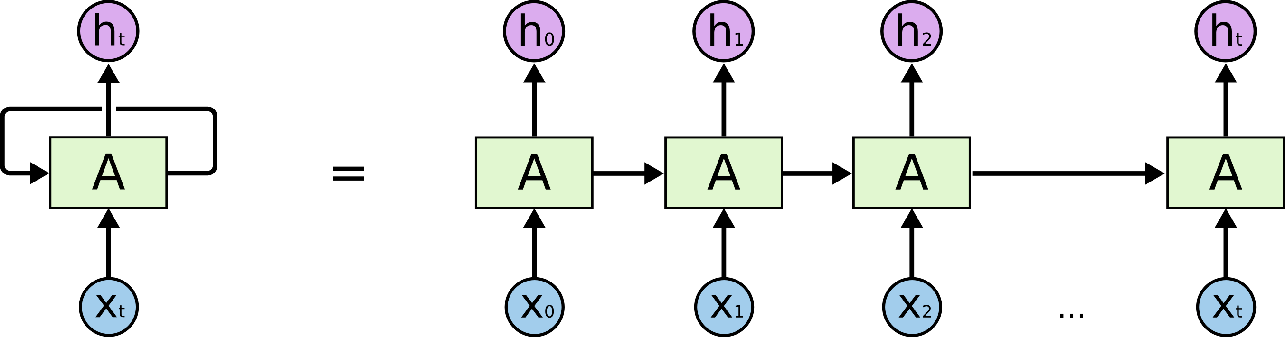
Recurrent Neural Network
https://towardsdatascience.com/understanding-rnn-and-lstm-f7cdf6dfc14e

Slide 7
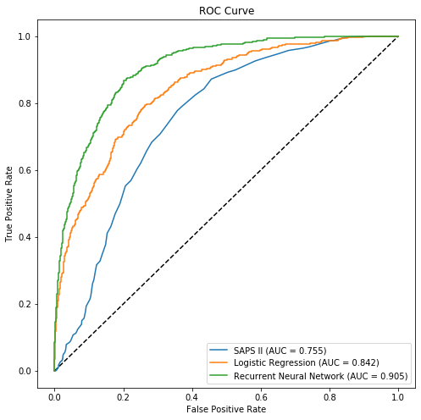
Results

Slide 8
Summary
Was I able to reproduce the published results?
Limitation – interpretability!
How accurately can I predict survival?
Accuracy = 62%, Sensitivity = 59%, Specificity = 82%
 | My Results (AUC) | Published Results (AUC)
Logistic Regression | 0.842 | 0.775 (0.834)
Recurrent Neural Network | 0.905 | 0.873 (0.941)

Slide 9
Mechanical Ventilation

Slide 10
AI in Mechanical Ventilation
Patient-ventilator
asynchrony ^{[2]}
AI in Ventilation
Weaning from
mechanical
ventilation ^{[4]}
Control of
ventilator
settings ^{[3]}

Slide 11
Clinical Challenges
Preventing
lung injury
Optimising gas exchange
Preventing/
treating diaphragm dysfunction
Liberating patients from ventilation
Lancet Review,
Published in 2016 ^{[5]}

Slide 12
Some questions
Do the challenges outlined here reflect clinical experience?
Are there other clinical challenges in ventilation that we haven’t touched on?
What data is available?

Slide 13
References
[1] S. Purushotham, C. Meng, Z. Che and Y. Liu, "Benchmarking deep learning models on large healthcare datasets", Journal of Biomedical Informatics, vol. 83, pp. 112-134, 2018
[2] L. Zhang et al., "Detection of patient-ventilator asynchrony from mechanical ventilation waveforms using a two-layer long short-term memory neural network", Computers in Biology and Medicine, vol. 120, p. 103721, 2020
[3] F. Akbulut, E. Akkur, A. Akan and B. Yarman, "A decision support system to determine optimal ventilator settings", BMC Medical Informatics and Decision Making, vol. 14, no. 1, 2014
[4] N. Prasad, LF Cheng, C. Chivers et al. “A reinforcement learning approach to weaning of mechanical ventilation in intensive care units”, Conference on Uncertainty in Artificial Intelligence Proceedings, 2020
[5] EC Coligher, ND Fergusn, LJ Brchard, “Clinical challenges in mechanical ventilation", The Lancet, vol. 387, pp. 1856-1866, 2016

Slide 14
Thank you!

